Slide 1
Controlling Procedural Modeling Programs with Stochastically-Ordered Sequential Monte Carlo
Daniel Ritchie Ben Mildenhall Noah D. Goodman Pat Hanrahan
Stanford University
Notes:
Procedural models let people create a variety of detailed content without a lot of repetitive effort.

Slide 2
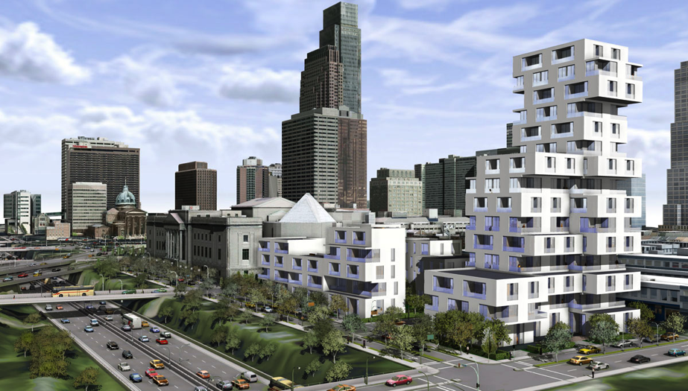
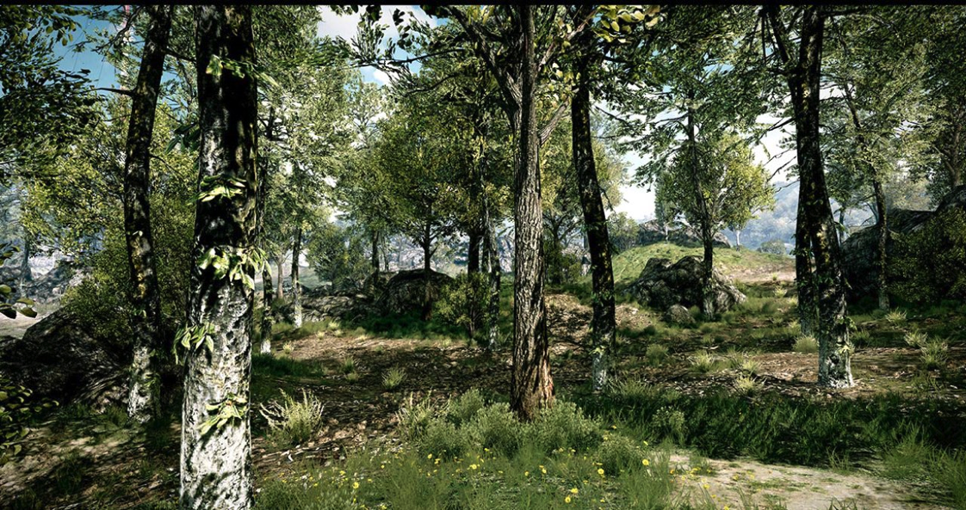
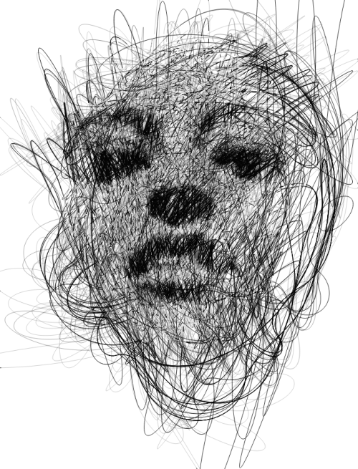

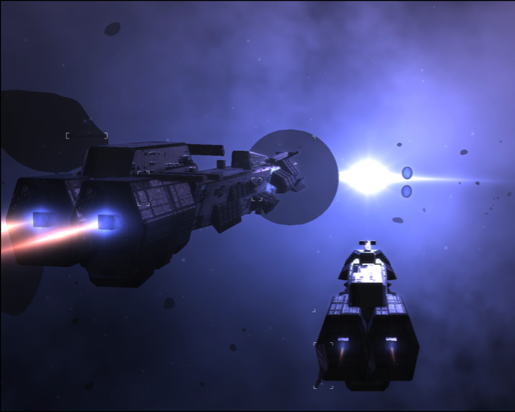
[ESRI CityEngine]
[SpeedTree]
[Limit Theory]
[Gestural Memory, Sergio Albiac]
[Fugu]
Notes:
Used to create cities, forests, spaceships and planets, strange alien plant life, and other forms of art.

Slide 3
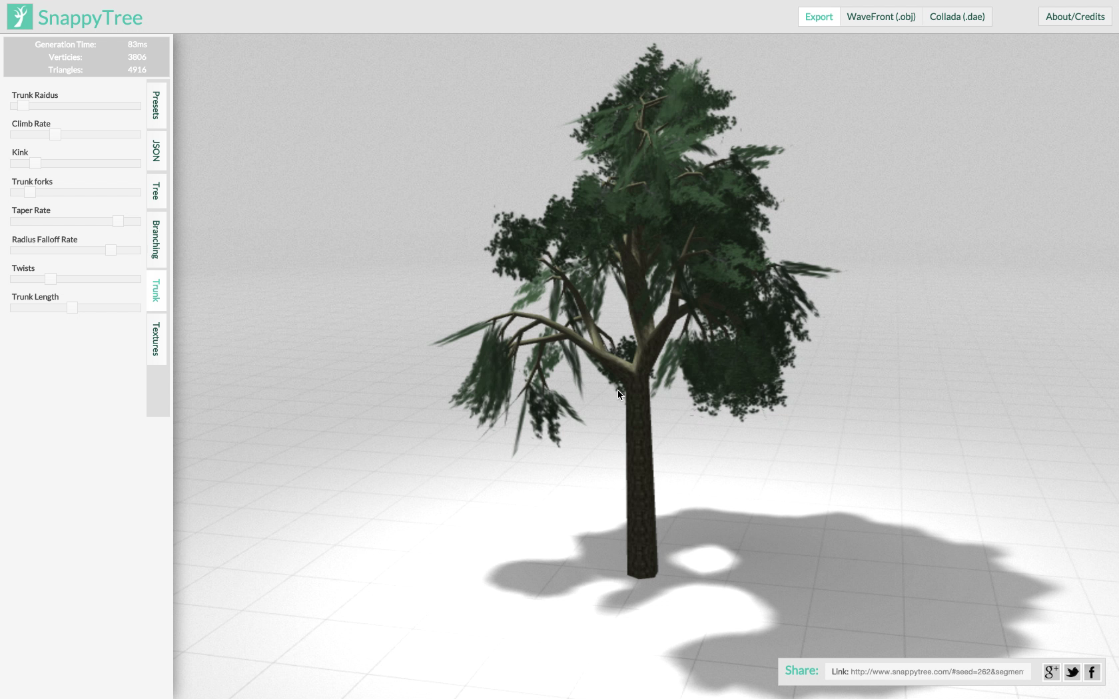
Notes:
But they’re also usually highly parameterized, structured, and even recursive.
Small changes in params can lead to unpredictable emergent behavior,
Like the abrupt changes in the appearance of this tree.

Slide 4
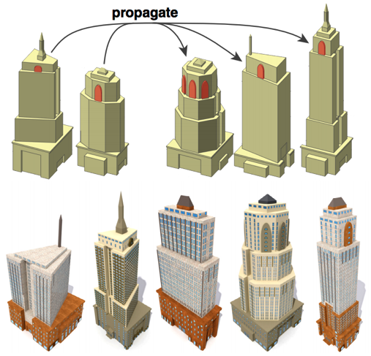
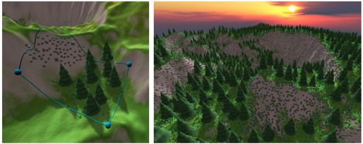
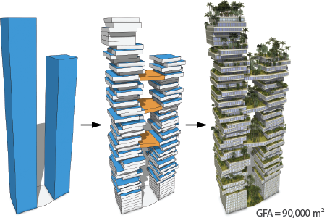
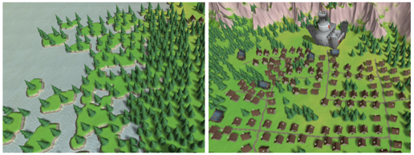
Controlling Procedural Models
Learning Shape Placements
WorldBrush
CGA++
Examples
Interactive Painting
Context Sensitivity
Multi-Shape Coordination
Procedural Model = Repeatable Interaction Trace
Notes:
Not surprising that there’s an interest in tools for controlling proc mods.
All the papers in this session can be seen from this perspective.
Whether it’s controlling their style and placement through examples and interactive painting…
…controlling architecture context-sensitive decision making and coordination…
…or recording interactive modeling sessions which generalize predictably when replayed in new settings.
In this talk, I’ll focus on a different tool for procedural model control…

Slide 5
Bayesian Inference
model
random
choices
control
signal
Notes:
…Bayesian inference
Which casts procedural model control as sampling from a probability distribution.
Specifically, the distribution over the random choices the procedural model makes, conditioned on obeying some control signal.

Slide 6

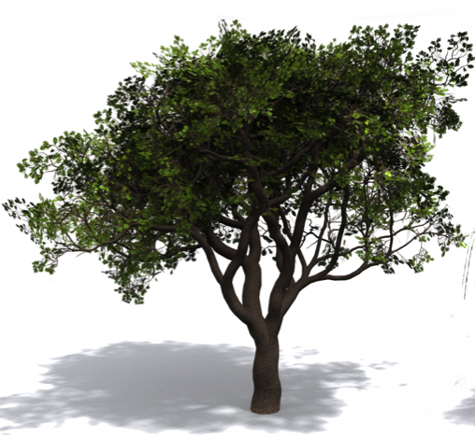

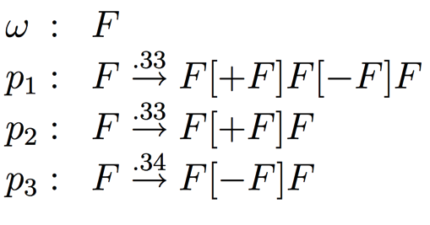
Bayesian Inference
prior
likelihood
Notes:
Using Bayes Rule, this distribution is proportional to the product of two terms
The first is the prior: the uncontrolled distribution over random choices.
Represented by an unconstrained procedural model, such as a stochastic L-system.
Which we can draw samples from by just running it forward.
The second is the likelihood: a score function that says how well a given set of random choices respects the control signal.
This might be a function measuring similarity to a target silhouette we’d like the model to have.
If we can sample from this product, then we can get results like this: models that can be generated by the prior, but that score well under the likelihood.

Slide 7
Bayesian Inference
[Talton et al. 2011]
[Talton et al. 2011]
Notes:
These images come from the Metropolis Procedural Modeling paper, which pioneered this idea several years ago.

Slide 8
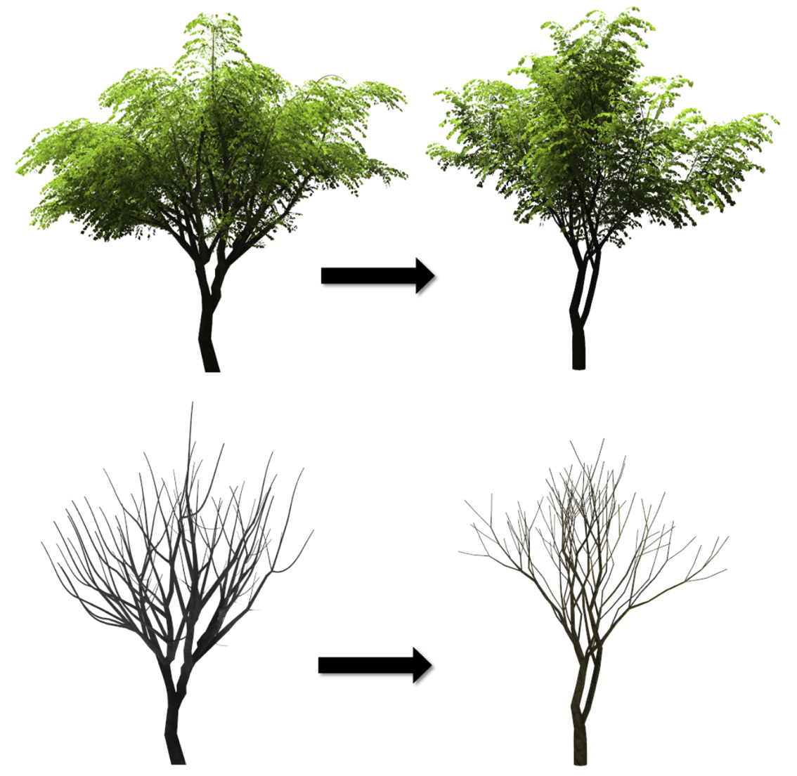
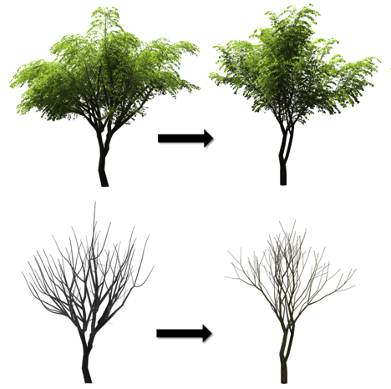
Bayesian Inference
[Talton et al. 2011]
[Stava et al. 2014]
[Stava et al. 2014]
Notes:
And since then, Bayesian inference has also been used to generate trees, where the likelihood is similarity to an existing polygonal tree model.

Slide 9
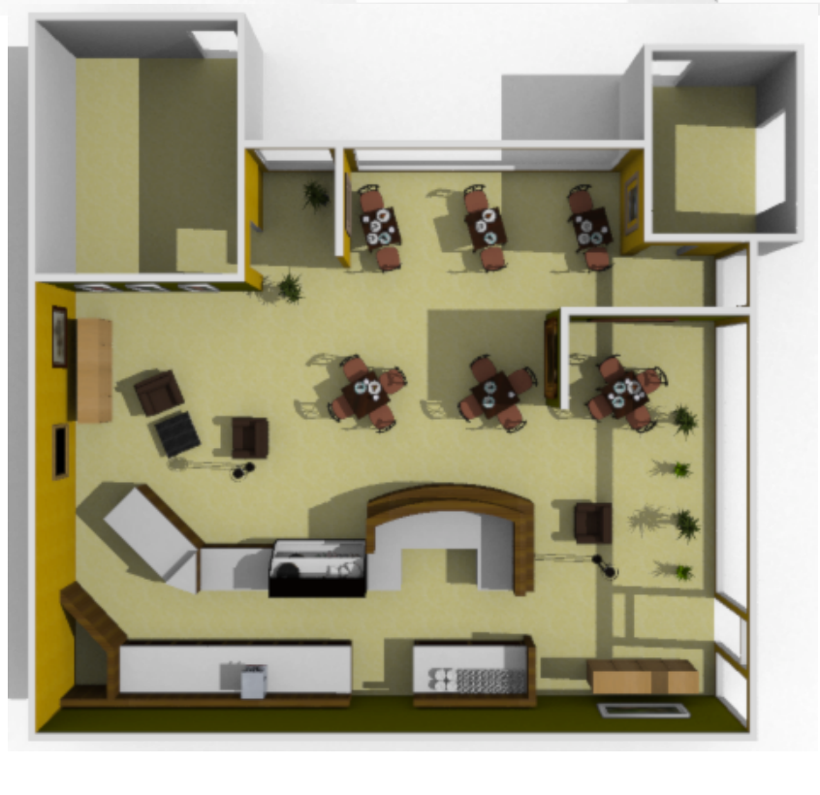
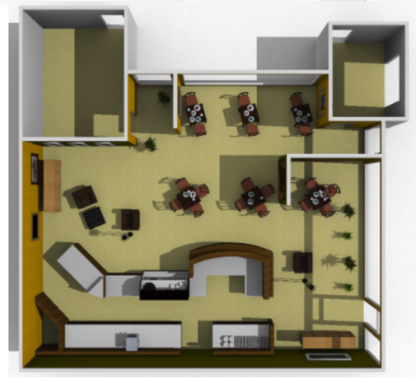
Bayesian Inference
[Talton et al. 2011]
[Stava et al. 2014]
[Yeh et al. 2012]
[Yeh et al. 2012]
Notes:
To generate furniture layouts, where likelihood models constraints on the spatial and angular relationships between tables and chairs and so on.

Slide 10
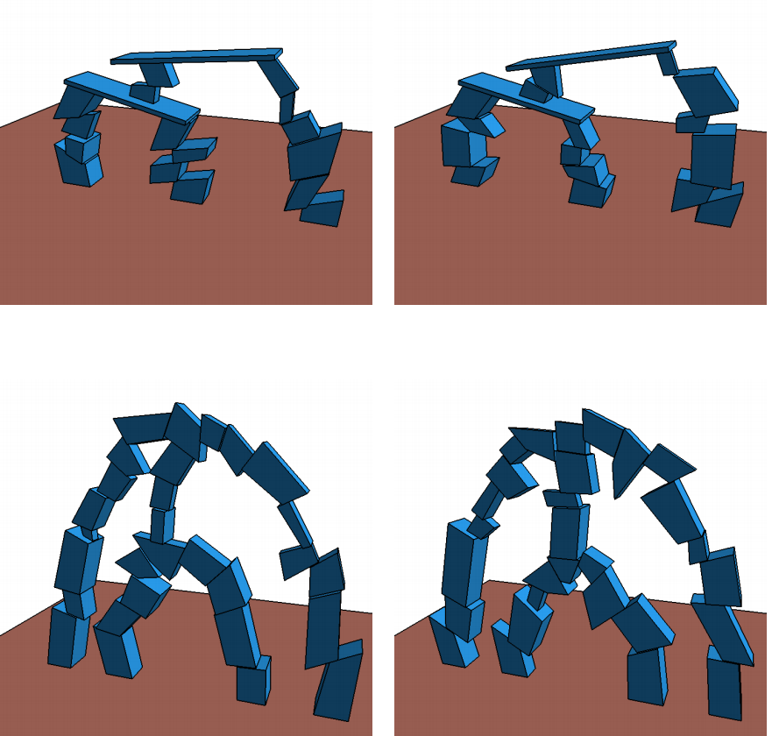
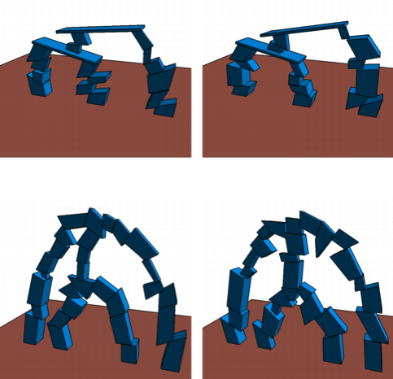
Bayesian Inference
[Talton et al. 2011]
[Stava et al. 2014]
[Yeh et al. 2012]
[Ritchie et al. 2015]
[Ritchie et al. 2015]
Notes:
And to generate structures that respect functional constraints, such as physical stability.
One thing that all of these systems have in common…

Slide 11
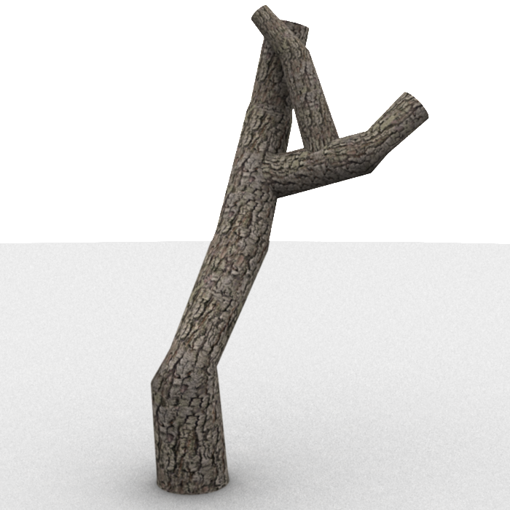

Metropolis Hastings
Target Shape
Notes:
…is they all use Metropolis Hasting algorithms to actually perform inference.
Here’s a quick overview of how that works.
Suppose we want to generate trees that have roughly this shape.
MH starts off in some random state drawn from the prior, maybe this one,
And then it alters the state by applying perturbation operators.

Slide 12
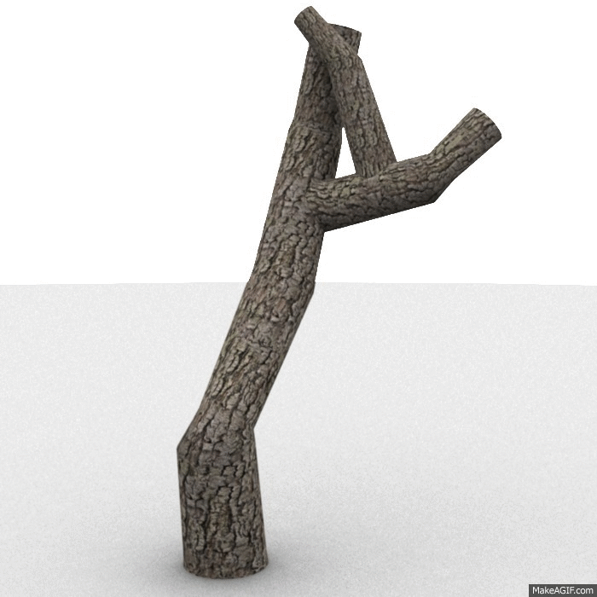
Metropolis Hastings
Continuous Change
Target Shape
Notes:
It might change some continuous random choices in the model, like the length of a tree branch

Slide 13

Metropolis Hastings
Discrete (Structural)Change
Target Shape
Notes:
Or it might change some discrete random choice, changing the structure of the model by, say, adding more branches.

Slide 14
Metropolis Hastings
…
Target Shape
Notes:
MH repeatedly applies these operators, accepting their changes if they increase likelihood (and sometimes even if they don’t, which lets it escape some local maxima).

Slide 15
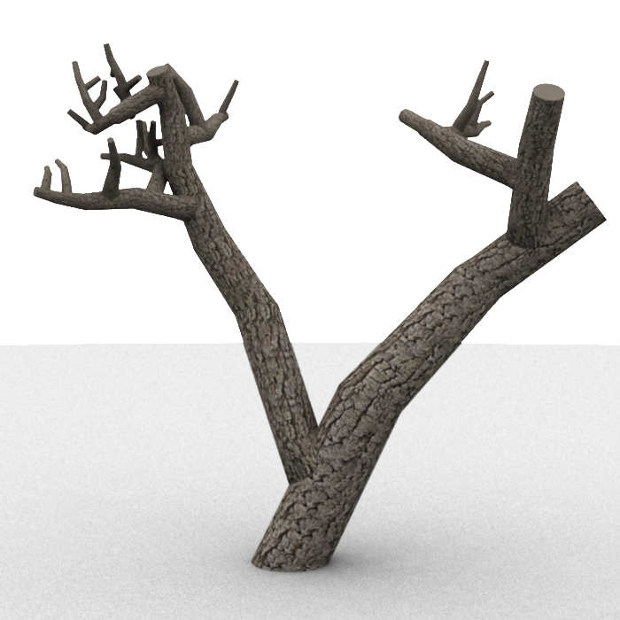


Metropolis Hastings
General-purpose
Slow
Target Shape
Notes:
And the hope is that this process eventually converges to a result like this one.
MH is a great general-purpose tool for just about any sampling problem like this…
…but it’s also notorious for taking a long time to converge to good results.

Slide 16
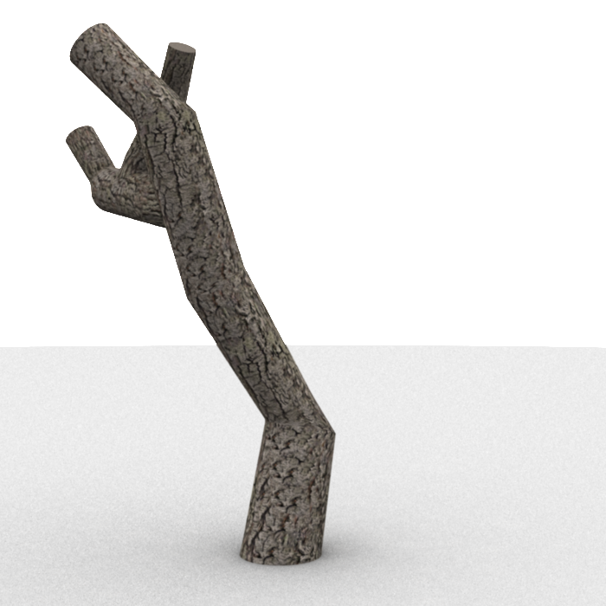
Metropolis Hastings
General-purpose
Slow
Target Shape
Delayed Rejection
Parallel Tempering
LARJ-MCMC
Notes:
It often gets stuck for a long time in states like this,
Where MH would have randomly spawn a second branch in just the right position and at just the right angle to make any more progress
People have developed a bunch of tricks to address problem, techniques such as
Delayed Rejection
Parallel Tempering
Locally-Annealed Reversible Jump algorithm
It’s a pretty well-studied area

Slide 17
What if we use a different inference algorithm entirely?
Notes:
So in this talk, I want to do something different, and instead ask: what if we didn’t use MH at all?
Is there perhaps a different core inference algorithm out there that might have something useful to offer for this problem?

Slide 18
…
Sequential Monte Carlo
(Particle Filtering)
[Gordon et al. 1993]
Notes:
Specific algorithm I want to look at is Sequential Monte Carlo, or SMC.
Which you might also know by the name “particle filtering”
Techniques that we’d recognize today as SMC have been around since the early 90’s
And they’ve been mostly used to do state estimation in time series models, such as Hidden Markov Models

Slide 19
SMC: Requirements
Random Choice
Sequence
“Local” Likelihood
Notes:
SMC is still a Bayesian inference algorithm, but it applies most naturally to models with certain properties.
First, the random choices in the model should occur in sequence:
They can be ordered from 1 to n
And it is easy to sample the ith choice given the values of the choices that precede it.
Also, the likelihood should be “local,” in the sense that we can evaluate it given only the first i random choices.
When evaluated with all n, that should be equal to the overall likelihood.

Slide 20
SMC: How It Works
1
1’
2
2’
Weight by
3
3’
4
4’
…
…
n
n’
Notes:
Assuming our model has these properties, then SMC works as follows:
We first initialize a set of particles by sampling from from prior over the first random choice, x1.
We can then evolve these particles forward by sampling x2 given the values of x1.
By the chain rule for probabilities, these particles are now distributed according to p(x1, x2).
We could keep on doing this, but that would just produce samples from the prior.
We really need to incorporate the control signal by using the likelihood function somehow.
So what we do is we weight these particles according to their local likelihood score.
Let’s say these two score really well, this one sort of OK, and these two score poorly.

Slide 21

SMC: How It Works
1
1’
1’
2
2’
1’
3
3’
3’
4
4’
4’
…
…
…
…
n
n’
4’
Notes:
We then resample these particles in proportion to these weights.
So these high-scoring particles might get resampled twice,
This ok-scoring one once,
And these low-scoring ones don’t get resampled at all, so they get killed off.
After this step, having taken the likelihood into account through resampling, it’s possible to show our particles are distributed according to this probability, conditioned on the control signal.
If we repeat this sample-then-resample process through all of our random choices, we end up with samples from the final distribution we care about.
Why might this be a good method for controlling procedural models?
Goes through the procedural model step-by-step, receiving feedback from the likelihood function at each step.
In contrast with MH, which starts by generating a complete structure, then just has to hope that it gets lucky and makes big enough random changes to escape whatever local maximum it’s gotten itself into.

Slide 22
SMC: Procedural Model Example
Spaceship generator
Probabilistic
Program
Notes:
So let’s actually see an example of applying SMC to a procedural model.
I’m going to use a model that generates random spaceships
And rather than using some kind of grammar, I’m going to write it down as a PROBABILISTIC PROGRAM.
Since they’re more general and (I think) easier to read.

Slide 23
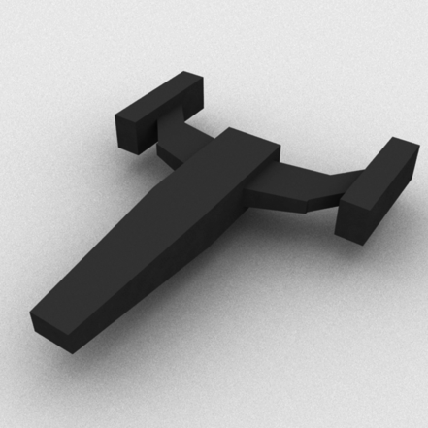
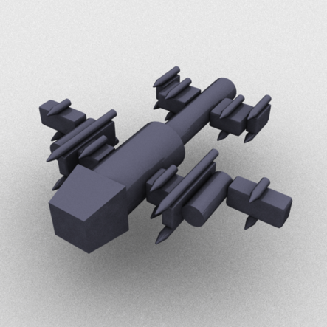
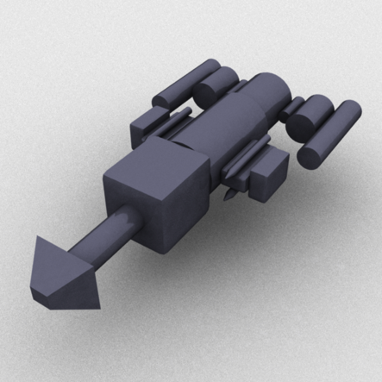
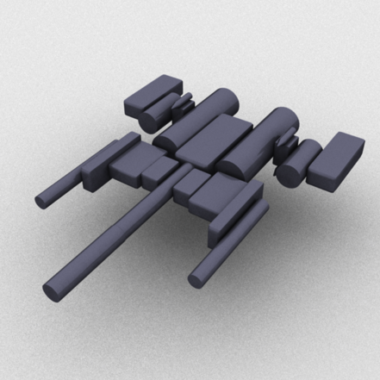
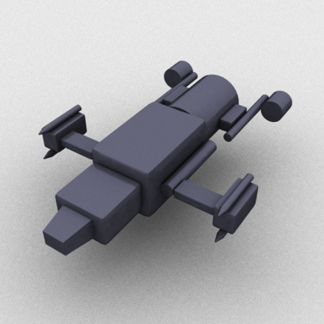
SMC: Procedural Model Example
function ship(pos) {
var newpos = genBody(pos)
if (flip(0.5))
wings(pos,newpos)
if (flip(0.5))
ship(newpos)
}
Target
Notes:
So we have our ship function
The first thing it does it generate a piece of the ship’s body.
Then, depending on a coin flip, it might generate wings protruding from the body.
And finally, depending on another coin flip, it’ll recursively keep generating.
For brevity, I’m not showing the ‘wings’ function, but it looks really similar, recursively generating a bunch of connected wing segments.
When we run this program, it generates objects like these.
Let’s say we want to constrain its output to take on roughly this shape.

Slide 24
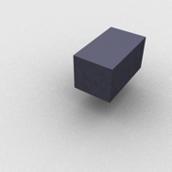
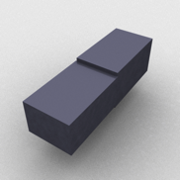
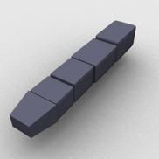
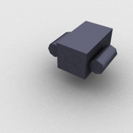
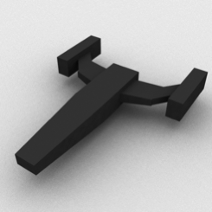
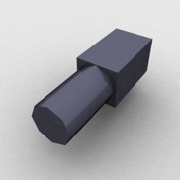
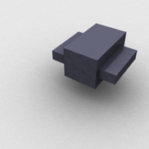
SMC: Procedural Model Example
“Filter Collapse”
Target
Notes:
So let’s run through the SMC process again for this specific example.
Here’s our target shape, again.
We first start up some particles that sample the first body piece of the ship.
The next thing that some of them do is start generating wings off of the body
while others skip the wings and generate the next body piece.
Then we score these particles.
Because the particles that generated two body segments will fill in more of the target volume, those will score much better than these other particles that have these stubby beginnings of wings.
So these particles will get resampled multiple times…
…while these ones will tend to die off.
So now we repeat these steps until the particles terminate, and we get…
…a bunch of ships with no wings. Huh. What’s going on here?
Back at the first resampling step, when we killed off those particles that were starting to generate wings, we killed off our chance of EVER generating wings there.
That’s because once the program decides not to generate wings and to move on to generating the next body piece, it can’t go back and reverse that decision.
Essentially, our particle filter is ‘collapsing’—the weight difference between high-weight and low-weight particles is really big, so resampling tends to cause one or a few high-weight particles to dominate, especially when accumulated over multiple resampling steps.
Great. Is there anything we can do about this problem?

Slide 25
Procedural Modeling Programs Have Structure
function ship(pos) {
var newpos = genBody(pos)
if (flip(0.5))
wings(pos,newpos)
if (flip(0.5))
ship(newpos)
}
Notes:
Fortunately, yes.
One of our main insights is that
While SMC is traditionally used on linear, time-series models,
Procedural models tend to have structure that we can exploit.
Let’s look at our ship generating program again.

Slide 26
Procedural Modeling Programs Have Structure
function ship(pos) {
var newpos = genBody(pos)
if (flip(0.5))
wings(pos,newpos)
if (flip(0.5))
ship(newpos)
}
Notes:
And look at these two recursive functions.
When we execute this program, we get a tree of function calls, like this one
There’s a “spine” of recursive calls to ship, off of which might spawn a bunch of recursive calls to ‘wings’
But I said earlier that SMC requires a linear sequence of random choices
This program has no obvious, canonical ‘time’ ordering,
so we need to linearize this tree somehow.

Slide 27
Many Linearization Orders
Depth-first Ordering
“Body-first” Ordering
Notes:
Of course, there are many possible ways to linearize.
In the example I just showed, I was using the depth-first ordering, which is the order in which most programming languages will execute, because they organize function calls on a stack.
But we could also do, say, an ordering that generates all the body pieces first, and then generates the wings.

Slide 28
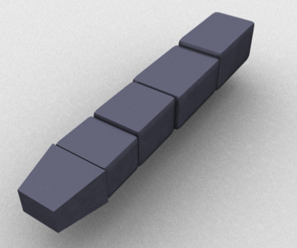
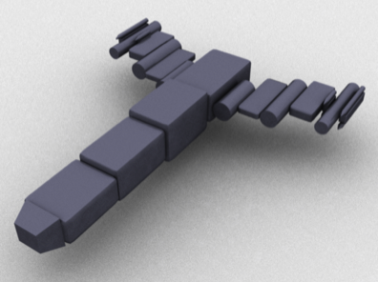
Ordering Affects SMC Behavior
Depth-first Ordering
“Body-first” Ordering
Notes:
Here’s the critical part: the linearization order we pick will change the behavior of SMC.
We already saw how using the depth-first ordering causes it to generate sad, wingless spaceships.
But if we use this ‘body-first’ ordering? No such problem—there’s no issue with SMC resampling being forced to pick body pieces over wing pieces.

Slide 29
How To Choose Order In General?
Depends on program
Depends on likelihood
Awkward to express in program text
Notes:
So we’ve solved our problem with spaceships, but how do we choose execution order in general, for any program? It’s not very clear how to do this.
It’ll depend on the procedural modeling program we’re using, obviously.
And we’ve seen how it also depends upon what likelihood function we use, like volumetric similarity.
And it can be really awkward and time-consuming to re-write the program to execute in different orders.
So we really need some way to automatically discover good orderings.

Slide 30
Idea: Randomize Order
(a la Multiple Importance Sampling)
Notes:
Here’s our key idea: we’re already doing stochastic sampling—why don’t we just randomize the execution order of every particle?
Hopefully this will lead SMC to discover and favor good orderings, as it resamples away the bad ones.
Those of you with a rendering background might recognize this idea of randomly combining different sampling strategies
As similar to what multiple importance sampling does.

Slide 31
Stochastically Ordered Sequential Monte Carlo
Notes:
This insight leads to an algorithm we call Stochastically Ordered Sequential Monte Carlo, or SOSMC for short.
Formally, what it does is to take our probability distribution…

Slide 32
Stochastically Ordered Sequential Monte Carlo
Notes:
…Introduce auxiliary random choices ‘o’ to represent ordering decisions
And then marginalize out those choices
There’s a proof in the paper that doing this doesn’t change the final distribution that SMC samples from.

Slide 33
Implementing Re-Ordering: Stochastic Futures
function ship(pos) {
var newpos = genBody(pos)
if (flip(0.5))
wings(pos,newpos)
if (flip(0.5))
ship(newpos)
}
Notes:
Ok, that’s nice in principle, but how do we actually implement random re-ordering for actual programs?
We do this by introducing a new programming primitive called the ‘stochastic future’.
Here’s our trusty spaceship program again.

Slide 34
Implementing Re-Ordering: Stochastic Futures
function ship(pos) {
var newpos = genBody(pos)
future(function() {
if (flip(0.5))
wings(pos,newpos)
})
future(function() {
if (flip(0.5))
ship(newpos)
})
}
“Future”
Will finish executing before
program terminates
“Stochastic”
Executed in random order
Notes:
And here’s the program transformed to use stochastic futures.
We’ve wrapped each of these recursive call blocks in an anonymous function, and passed that function to this ‘future’ operator.
So what does this do, exactly?
Well, the ‘future’ part of stochastic futures means that these functions don’t necessarily execute immediately—instead, we’re only guaranteed that they will finish executing before the program terminates.
And the ‘stochastic’ part means that they execute in a random order with respect to one another
Basically, under the hood, there’s a global queue, and functions get pulled off this queue at random until it’s empty.

Slide 35
Stochastic Future Details
Where to insert them?
Every if predicated on a random choice
Functional Language
Future :: Function
Imperative Language?
Future :: Co-routine
Notes:
There are a few more details that’re important to nail down about using stochastic futures.
First, where do you need to put them in a program?
They should wrap every conditional that’s predicated on the value of a random choice.
Basically, any time a random choice can cause the program to take a different execution path.
In our implementations, we’ve just done this by hand, but it’s totally possible to automate this with a source-to-source transformation.
I’ve also been saying that these stochastic futures are just functions, which is fine if you’re working in a purely functional programming language
But what about imperative languages, with looping constructs? We want to make sure that loop iterations of different futures can be re-ordered with respect to one another, which makes things more complicated.
In the paper, we outline an implementation for imperative languages that uses co-routines to represent futures.

Slide 36
Results
Notes:
Now that we know how it works, we can take a look at what SOSMC can actually do.

Slide 37
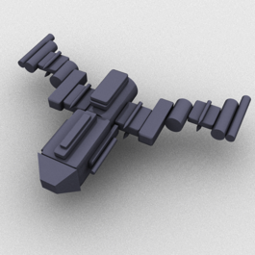
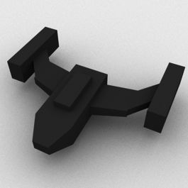
SOSMC Converges Faster than SMC or MH
Notes:
First, it tends to converge to high-likelihood results faster than MH or SMC using the depth-first ordering.
Here, I’m targeting the spaceship program to the shape in black.
I’ve plotted log-likelihood on the y axis against increasing computation time on the x-axis.
Each vertical slice through the graph compares these three algorithms when given the same amount of computation.
You can see that SOSMC converges faster than the other two methods.

Slide 38
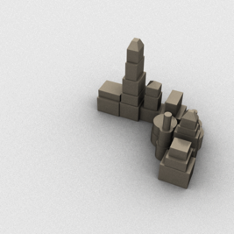
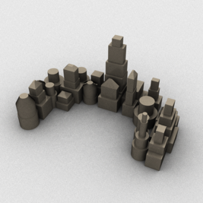
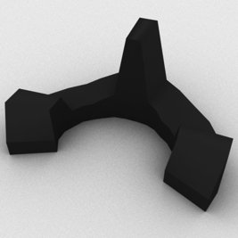
SOSMC Converges Faster than SMC or MH
Notes:
Here’s the same plot, but for a different program that grows a connected assembly of towers and silos.
One interesting thing going on here is that while SOSMC does well even with very few particles…
…ordering problems often cause depth-first SMC to miss generating an entire half of the target crescent shape
And if you look at the graph, it doesn’t seem to be converging to the same score level as the other two methods.

Slide 39
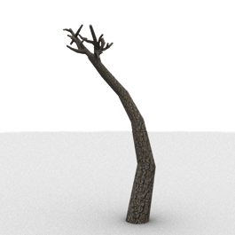

SOSMC Converges Faster than SMC or MH
Notes:
And here’s another plot for a tree program, targeted to a really long shape with a bulb at the end.
MH has the worst performance of all the methods on this one.
That’s because hitting this target shape requires a carefully-coordinated sequence of parameter choices,
which MH’s random mutation-based search process has a difficult time finding,
Whereas the sequential methods do better.

Slide 40
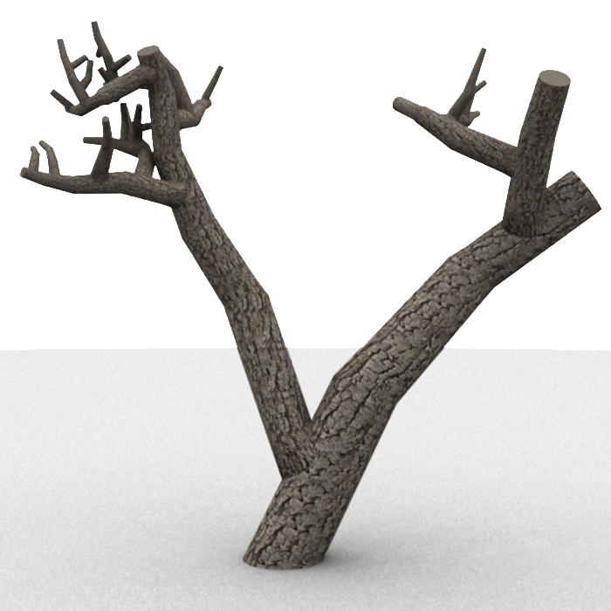
SOSMC Converges Faster than SMC or MH
SOSMC (22.47s)
MH (22.47s)
Target
Notes:
Finally, if we look back at one of our earlier examples, where we were trying to get the tree program to match this shape,
SOSMC found the result on the left after a little more than 20 seconds, whereas MH was still struggling after the same amount of time.

Slide 41

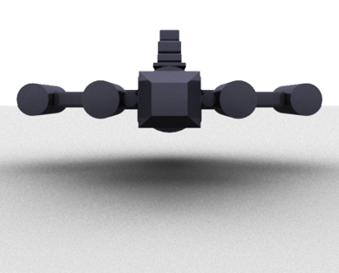
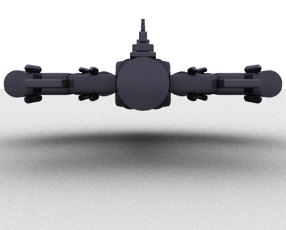
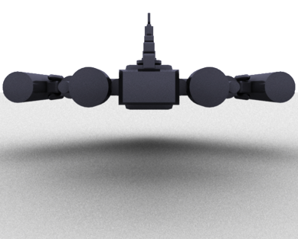
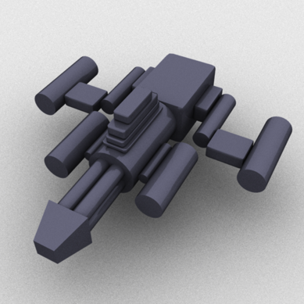
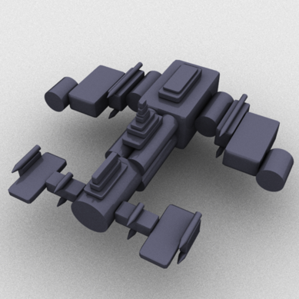
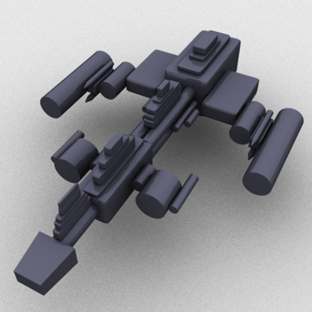
Image-Based Control: Silhouettes
Target
Front View
Top View
Notes:
Of course, we want to support more types of controls than just volumetric constraints, so here’s an example that uses image-based silhouette controls.
These spaceships all resemble the target image when viewed head-on, but are free to exhibit interesting variations from other perspectives.

Slide 42
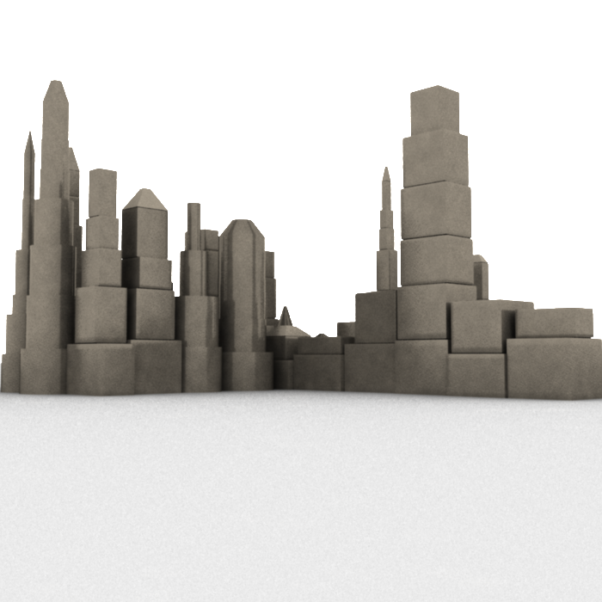
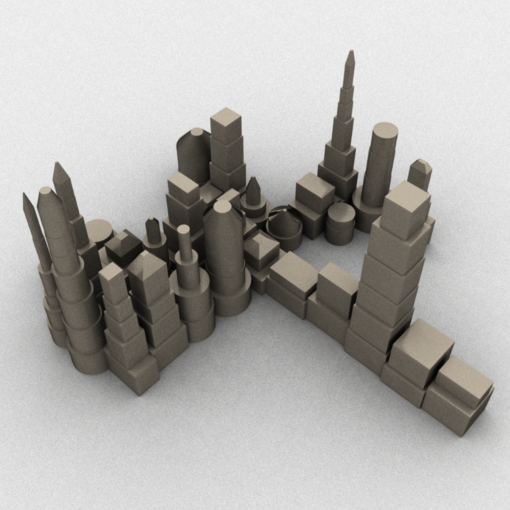

Image-Based Control: Silhouettes
Front View
Top View
Target
Notes:
And here’s a similar example where we generate skylines that match a target silhouette.

Slide 43



Image-Based Control: Shadows
Top View
Oblique View
Target
Notes:
We also played around with using SOSMC to control the shadows cast by objects.
So here we have a random scattering of blocks that cast a shadow in the shape of a face when lit from a particular angle.

Slide 44

Image-Based Control: Shadows
Notes:
And here’s another example of a program that generates a maze of pipes which casts a shadow in the shape of the number 15.

Slide 45
Limitations
Notes:
Of course, SOSMC also has some limitations

Slide 46


SOSMC Still Exhibits Filter Collapse
Target
SOSMC Final Particles
Notes:
I want to highlight that it still suffers a bit from that ‘filter collapse’ problem I mentioned earlier.
Here I’m showing a subset of the final set of particles that come out of SOSMC when targeting the spaceship program to the shape on the left.
You can see that while random execution re-ordering solves the no-wings problem we had earlier…these results all look really similar to one another.
And that’s because a few high-scoring particles are still dominating on every resampling iteration, so the longer it runs, the more similar the histories of all the particles start to look.

Slide 47

MH Also Produces Nearly-Identical Samples
MH Final States
SOSMC Final Particles
Notes:
It’s worth pointing out that MH has a very similar problem.
Once it converges to a high-scoring solution, it tends to get stuck wiggling around that solution, rather than forging off in search of new ones.
Both algorithms have some techniques for mitigating this behavior, but they can be computationally expensive.

Slide 48
Looking Forward
Notes:
Before I wrap up, I want to take a moment to look toward the future.
Hopefully, I’ve convinced you that for Bayesian procedural model control, SOSMC can be faster than previous methods.

Slide 49

[No Man’s Sky]
Notes:
…but is it fast enough for a game like No Man’s Sky, which generates procedural content on the fly, in real-time?

Slide 50

[Autodesk Homestyler]
Notes:
…or how about an interactive design tool, like Autodesk Homestyler, that needs to react quickly to user input?
The answer is…probably not yet. We still have a ways to go to make our algorithms fast enough for these use cases.
And I think something that might help us get there…

Slide 51



Probabilistic Programming for Procedural Modeling
Insights from programming languages / compilers
Powerful representation
[Kulkarni et al. 2015]
[Li et al. 2015]
Notes:
…is really embracing the view of procedural models as probabilistic programs.
For one thing, there are useful techniques we can borrow from the PL and compilers literature.
Personally, I wouldn’t have thought of using SMC for procedural models, much less have come up with stochastic ordering, without this perspective.
As a community, we’ve done a really good job at integrating tools from optimization, ML, and AI, and I think this is the next field to focus on.
Also, programs are a really powerful representation for procedural models. They’re Turing-complete, so they can capture any generative process you can come up with.
I think this’ll be especially relevant for Bayesian computer vision and 3D reconstruction, where the prior is some process that generates possible scenes, and the likelihood scores how well those scenes match an observed image / scan.
We’ll need to learn complex, structured priors for these problems, and in the long run, I think programs might be the only representation powerful enough to capture them.

Slide 52



Thanks!
Original Source Code:
https://github.com/dritchie/procmod
Web Demo:
https://dritchie.github.io/web-procmod
Notes:
And that’s the end of my talk.
I just want to point out that the original source code used to generate the results in the paper
As well as the web-based demo that I showed during the fast forward session
Are both available online.
Thanks for your attention, and I’d be happy to take questions.

Slide 53
“Garden Paths”
Constraints
1
5
1)
1
2
2
4
6
2)
1
3
3
1
2
Notes:
SMC methods are also susceptible to a phenomenon called “garden paths,” which is best explained by example.
Suppose I have a program that generates random points on the plane.
And then I want to subject these points to a couple of constraints.
First, the distance between every two subsequent points should be approximately d
And second, the angle between every three consecutive points should be as flat as possible.

Slide 54
“Garden Paths”
Constraints
1
6
2
1)
1
2
5
2)
1
3
3
1
4
2
Notes:
Under these constraints, the optimal configuration of points is a circle.

Slide 55
“Garden Paths”
Constraints
1)
1
2
1
2
3
4
5
6
2)
1
3
1
2
Notes:
But let’s look at what SMC will do in this case.
It’s free to put the first point anywhere.
It’ll favor putting the second point at a distance d away from the first point.
The third point will go distance d away from the second, and it’ll try to make a straight line of the three points, to optimize the second constraint.
(At this point, you can probably see what’s coming)
It keeps going like this until it has to place the last point…and at this point, the best it can do it to put it somewhere around here.
Not very circular, is it?
For problems like this, the ability to revise past decisions is critical, so it’s best to use methods like Metropolis Hastings instead of – or at least in combination with -- SMC.

